Slide 1
Cryptography (2022 Fall) DES
LiangFeng Zhang
zhanglf@shanghaitech.edu.cn
SIST, ShanghaiTech

Slide 2
Practical Constructions
Stream Ciphers:
LFSR (linear feedback shift register);
NFSR (nonlinear feedback shift register);
Combination Generator
Trivium, RC4
Block Ciphers: Shannon’s Confusion-Diffusion Paradigm
Feistel Network
DES (Data Encryption Standard)
Substitution-Permutation Network
AES (Advanced Encryption Standard)
Hash Functions:
Davies–Meyer Construction
MD5 (Message Digest 5)
SHA (Secure Hash Algorithm)

Slide 3
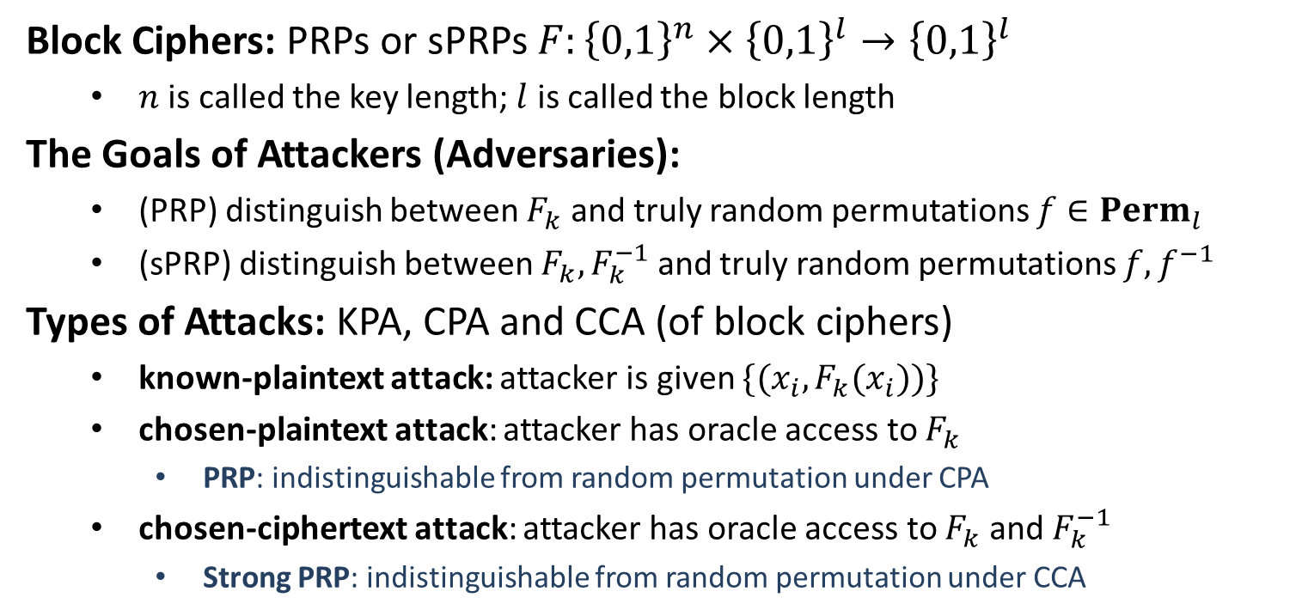
Block Ciphers
Block Ciphers: PRPs or sPRPs $F:{\left\{0,1\right\}}^{n}×{\left\{0,1\right\}}^{l}→{\left\{0,1\right\}}^{l}$
$n$ is called the key length; $l$ is called the block length
The Goals of Attackers (Adversaries):
(PRP) distinguish between $F_{k}$ and truly random permutations $f∈Perm_{l}$
(sPRP) distinguish between $F_{k}, F_{k}^{−1}$ and truly random permutations $f,f^{−1}$
Types of Attacks: KPA, CPA and CCA (of block ciphers)
known-plaintext attack: attacker is given $\{(x_{i}, F_{k}(x_{i}))\}$
chosen-plaintext attack: attacker has oracle access to $F_{k}$
PRP: indistinguishable from random permutation under CPA
chosen-ciphertext attack: attacker has oracle access to $F_{k}$ and $F_{k}^{−1}$
Strong PRP: indistinguishable from random permutation under CCA

Slide 4


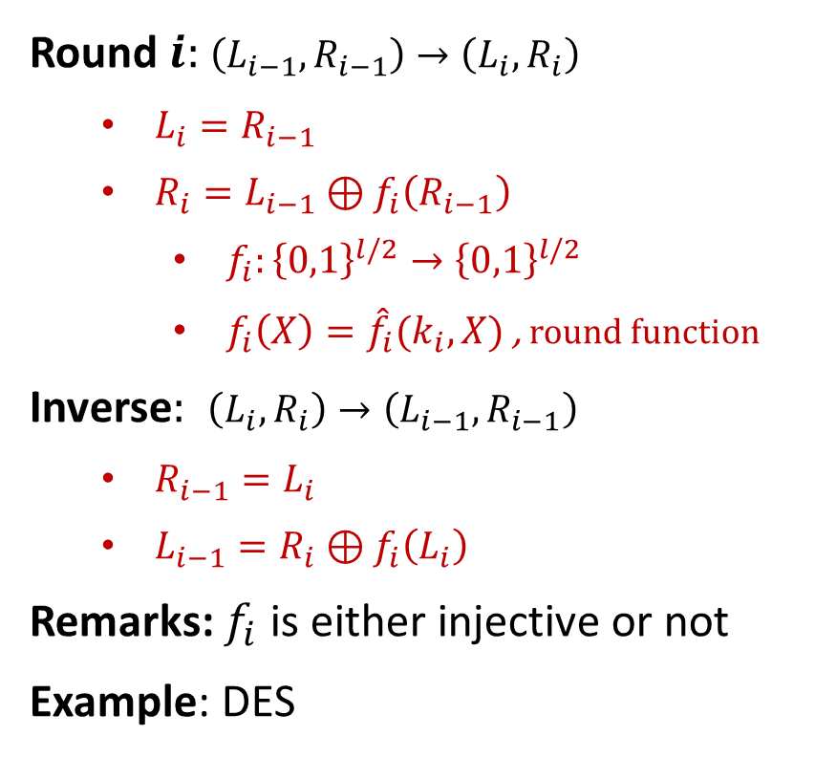









Feistel Network
$$L_{0}$$
$$R_{0}$$
Round $i:$ $\left(L_{i−1},R_{i−1}\right)→\left(L_{i},R_{i}\right)$
$L_{i}=R_{i−1}$
$R_{i}=L_{i−1}⊕f_{i}\left(R_{i−1}\right)$
$f_{i}:{\left\{0,1\right\}}^{l/2}→{\left\{0,1\right\}}^{l/2}$
$f_{i}\left(X\right)={\hat{f}}_{i}(k_{i},X)$ , round function
Inverse$:$ $\left(L_{i},R_{i}\right)→\left(L_{i−1},R_{i−1}\right)$
$R_{i−1}=L_{i}$
$L_{i−1}=R_{i}⊕f_{i}\left(L_{i}\right)$
Remarks: $f_{i}$ is either injective or not
Example: DES
$$f_{1}$$
$$L_{1}$$
$$R_{1}$$
$$f_{2}$$
$$L_{2}$$
$$R_{2}$$
$$f_{3}$$
$$L_{3}$$
$$R_{3}$$

Slide 5
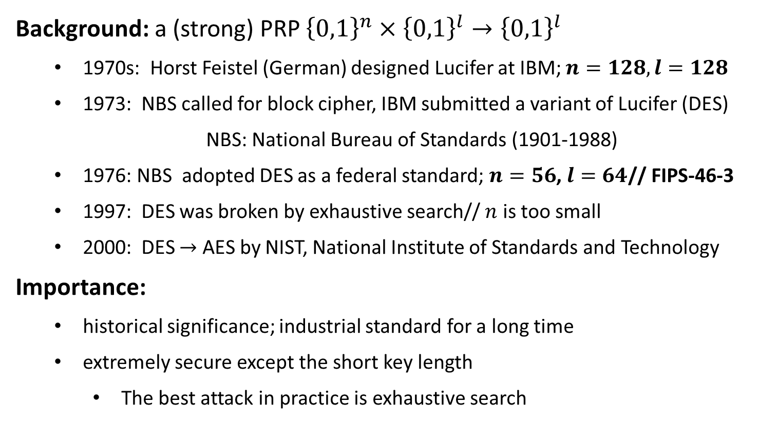
Data Encryption Standard (DES)
Background: a (strong) PRP ${\left\{0,1\right\}}^{n}×{\left\{0,1\right\}}^{l}→{\left\{0,1\right\}}^{l}$
1970s: Horst Feistel (German) designed Lucifer at IBM; $n=128, l=128$
1973: NBS called for block cipher, IBM submitted a variant of Lucifer (DES)
NBS: National Bureau of Standards (1901-1988)
1976: NBS adopted DES as a federal standard; $n=56$, $l=64$// FIPS-46-3
1997: DES was broken by exhaustive search// $n$ is too small
2000: DES $→$ AES by NIST, National Institute of Standards and Technology
Importance:
historical significance; industrial standard for a long time
extremely secure except the short key length
The best attack in practice is exhaustive search

Slide 6





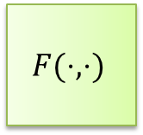












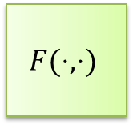


DES Encryption
$56$-bit
secret key $k$
key schedule
$48$-bit
$$k1$$
$$k2$$
$$⋯$$
$$k16$$
$$F(⋅,⋅)$$
$$F(⋅,⋅)$$
$$F(⋅,⋅)$$
$$m$$
$$IP$$
$$⋯$$
$$SW$$
$$IP^{−1}$$
$$c$$
$$L_{0},R_{0}$$
$$L_{1},R_{1}$$
$$L_{2},R_{2}$$
$$L_{16},R_{16}$$
$64$-bit
$64$-bit

Slide 7
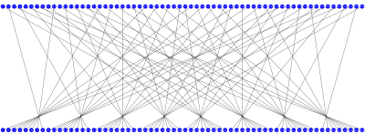
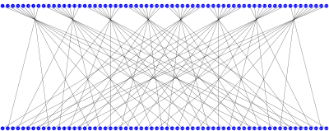
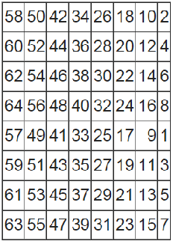
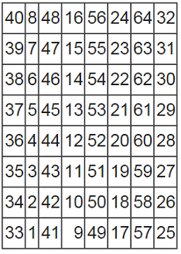





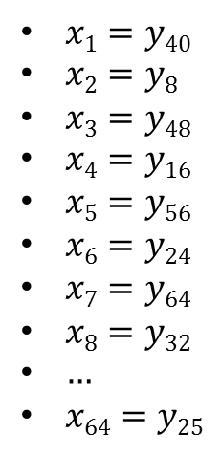
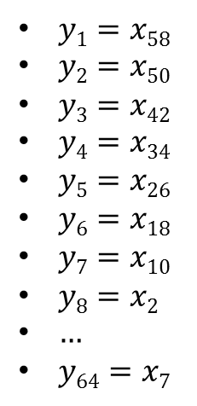

Initial Permutation IP
$$x=x1x2x3⋯x64$$
$$y=y1y2y3⋯y64$$
$$y=y1y2y3⋯y64$$
$$x=x1x2x3⋯x64$$
$$IP$$
$IP^{−1}$
$y1=x58$
$y2=x50$
$y3=x42$
$y4=x34$
$y5=x26$
$y6=x18$
$y7=x10$
$y8=x2$
$…$
$y64=x7$
$x1=y40$
$x2=y8$
$x3=y48$
$x4=y16$
$x5=y56$
$x6=y24$
$x7=y64$
$x8=y32$
$…$
$x64=y25$

Slide 8
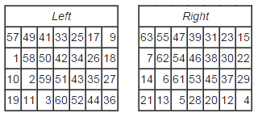
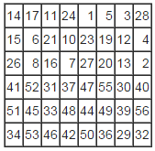








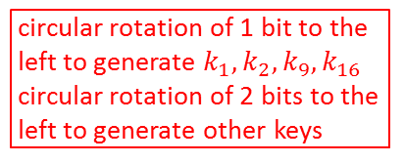







Key Schedule
64-bit key $K$
$$PC1$$
PC1
circular rotation of 1 bit to the
left to generate $k_{1},k_{2},k_{9},k_{16}$
circular rotation of 2 bits to the
left to generate other keys
28-bit
28-bit
<
<
28-bit
28-bit
PC2
48-bit $k1$
<
<
28-bit
28-bit
PC2
48-bit $k2$
64-bit $K→$ 56-bit $k$
<<
<<
$$PC2$$
28-bit
28-bit
PC2
48-bit $k3$
$$⋮$$
$$⋮$$
<
<
28-bit
28-bit
PC2
48-bit $k9$
<<
<<
28-bit
28-bit
PC2
48-bit $k10$
$$⋮$$
$$⋮$$
<
<
56-bit$→$48-bit
28-bit
28-bit
PC2
48-bit $k16$

Slide 9







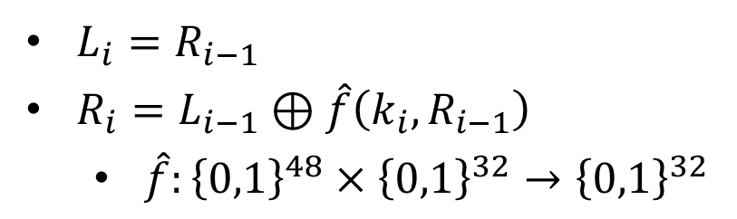
$$F(k_{i},L_{i−1}||R_{i−1})$$
32-bit
32-bit
$$L_{i−1}$$
$R_{i−1}$
$$⊕$$
$L_{i}=R_{i−1}$
$R_{i}=L_{i−1}⊕\hat{f}\left(k_{i}, R_{i−1}\right)$
$\hat{f}:{\left\{0,1\right\}}^{48}×{\left\{0,1\right\}}^{32}→{\left\{0,1\right\}}^{32}$
$$\hat{f}(k_{i},⋅)$$
$L_{i}$
$R_{i}$

Slide 10
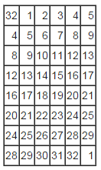
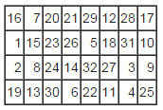
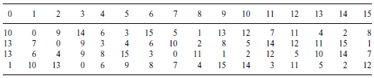























The DES Mangler Function $\hat{f}(k_{i},⋅)$
$$32 bits$$
$$48 bits$$
$R_{i−1}$
$k_{i}$
$$E$$
$$48 bits$$
$$P$$
$$⊕$$
$$48 bits$$
$E$/ expansion function
$$S1$$
$$S2$$
$$S3$$
$$S4$$
$$S5$$
$$S6$$
$$S7$$
$$S8$$
$$32 bits$$
$$P$$
$$S3$$
$$\hat{f}(k_{i},R_{i−1})$$

Slide 11
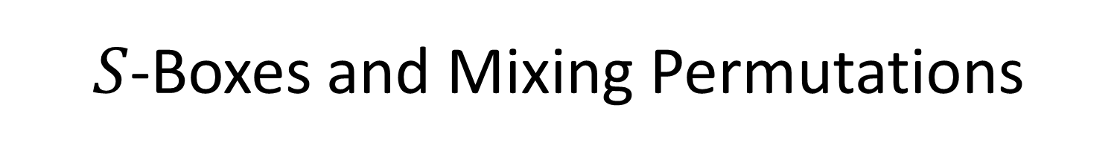
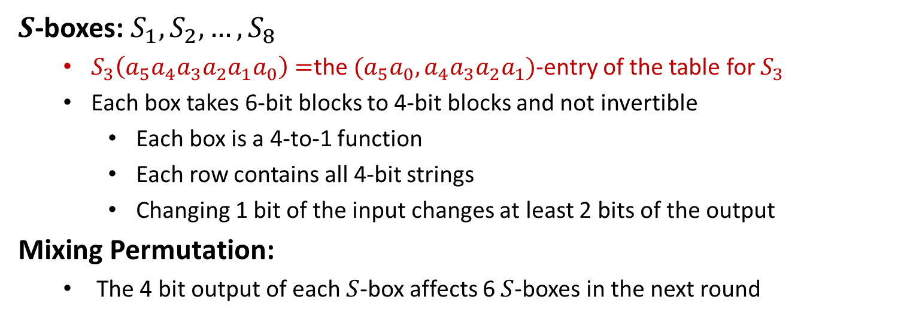
$S$-Boxes and Mixing Permutations
$S$-boxes: $S_{1}, S_{2},…,S_{8}$
$S_{3}\left(a_{5}a_{4}a_{3}a_{2}a_{1}a_{0}\right)=$the $(a_{5}a_{0},a_{4}a_{3}a_{2}a_{1})$-entry of the table for $S_{3}$
Each box takes 6-bit blocks to 4-bit blocks and not invertible
Each box is a 4-to-1 function
Each row contains all 4-bit strings
Changing 1 bit of the input changes at least 2 bits of the output
Mixing Permutation:
The 4 bit output of each $S$-box affects 6 $S$-boxes in the next round

Slide 12




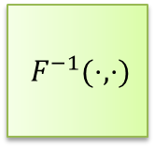







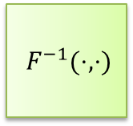








DES Decryption
$56$-bit
secret key $k$
key expansion
$48$-bit
$$k1$$
$$k2$$
$$⋯$$
$$k16$$
$F^{−1}(⋅,⋅)$
$F^{−1}(⋅,⋅)$
$F^{−1}(⋅,⋅)$
$$m$$
$$IP^{−1}$$
$$⋯$$
$$IP$$
$$SW$$
$$c$$
$$L_{0},R_{0}$$
$$L_{1},R_{1}$$
$$L_{2},R_{2}$$
$$L_{16},R_{16}$$
$64$-bit
$64$-bit
The DES Decryption: inverse $F\left(k_{1},⋅\right),…,F(k_{16},⋅)$
$R_{i−1}=L_{i}, L_{i−1}=R_{i}⊕\hat{f}(k_{i},L_{i})$

Slide 13
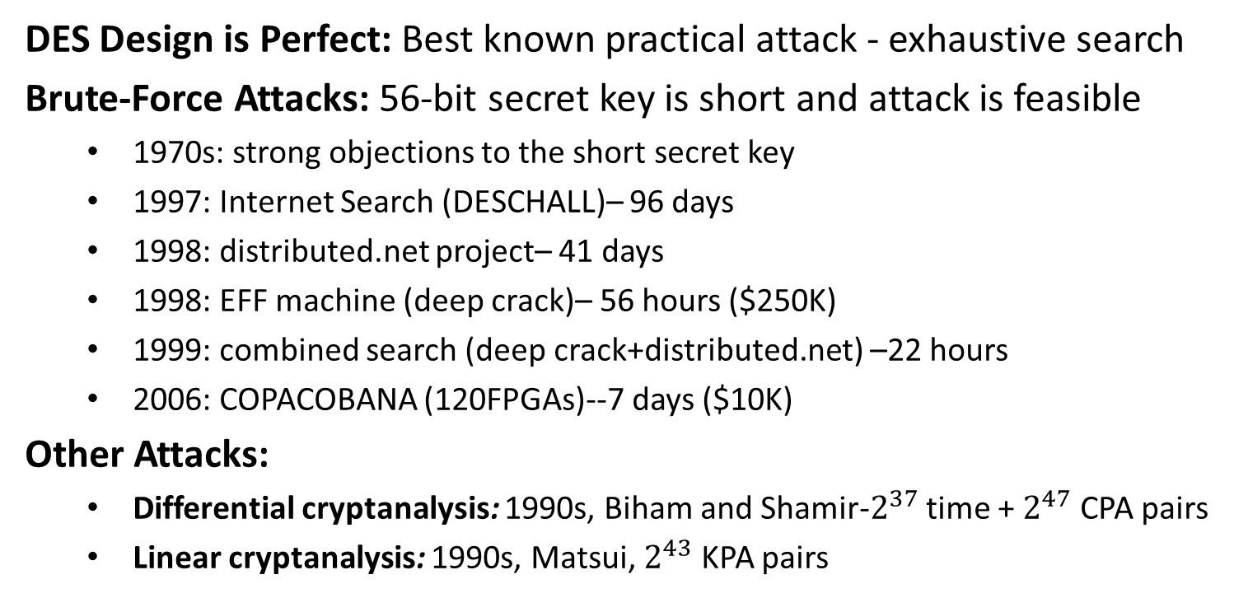
Security
DES Design is Perfect: Best known practical attack - exhaustive search
Brute-Force Attacks: 56-bit secret key is short and attack is feasible
1970s: strong objections to the short secret key
1997: Internet Search (DESCHALL)– 96 days
1998: distributed.net project– 41 days
1998: EFF machine (deep crack)– 56 hours ($250K)
1999: combined search (deep crack+distributed.net) –22 hours
2006: COPACOBANA (120FPGAs)--7 days ($10K)
Other Attacks:
Differential cryptanalysis: 1990s, Biham and Shamir-$2^{37}$ time + $2^{47}$ CPA pairs
Linear cryptanalysis: 1990s, Matsui, $2^{43}$ KPA pairs

